Slide 1


GCSE French at John O’Gaunt School
Why study GCSE French?
What will I study?
How will I be assessed?

Slide 2
Why study GCSE French?
It is an asset for your employability – studying a language opens doors to a variety of different jobs such as education, translation, marketing, publishing, journalism, sales and travel.
The skill and dedication involved in studying languages are highly regarded by universities and employers
French is a top-ten world language with over 300 million first-language speakers
French is the official language of the UN, EU, UNESCO, NATO, the International Olympic Committee, the International Red Cross and international courts
Learning French will enable you to enjoy books, films and songs in the language and strengthen your cultural knowledge

Slide 3
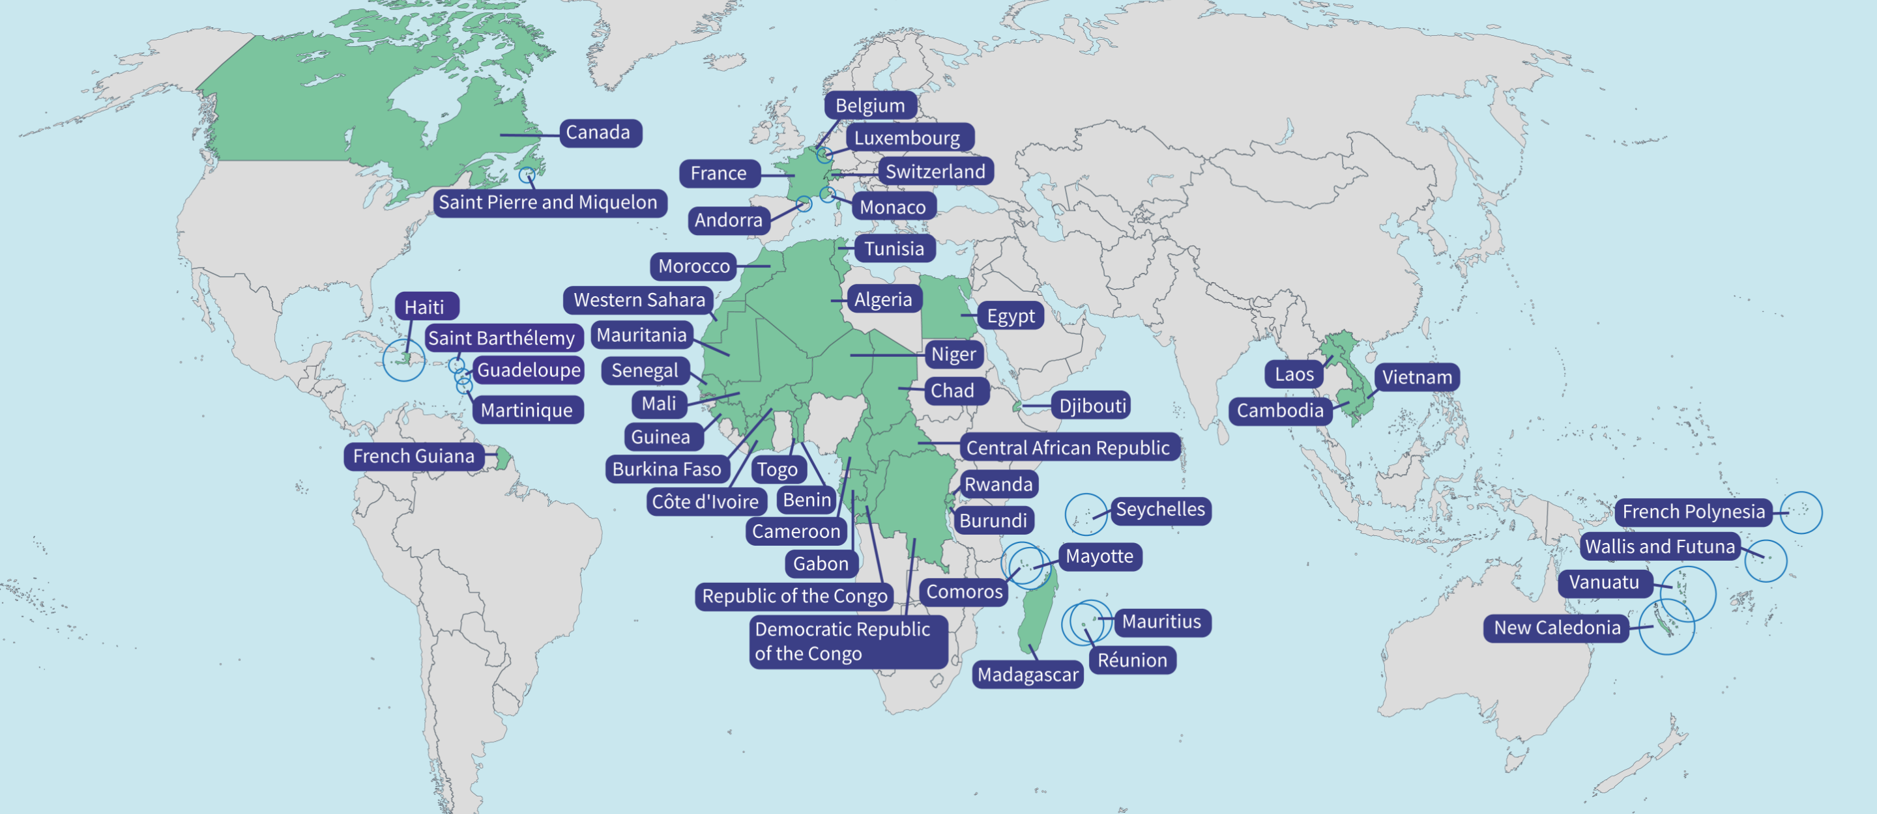
Why study GCSE French?

Slide 4
Why study GCSE French?
French lessons provide variety in KS4 – they can require a different set of skills compared to other subjects.
What do current GCSE students say about French lessons at JOG?
A normal French lesson consists of multiple different activities that target different skills, for example, we recently played a game of Guess Who? in class which targeted our listening and speaking skills
We learn in a supportive atmosphere where making mistakes is okay!
I really look forward to French lessons each week because of the calm atmosphere and contrast to skills required in my other subjects. I feel that I am supported with my learning
I feel that the French lessons are very inclusive and fun

Slide 5
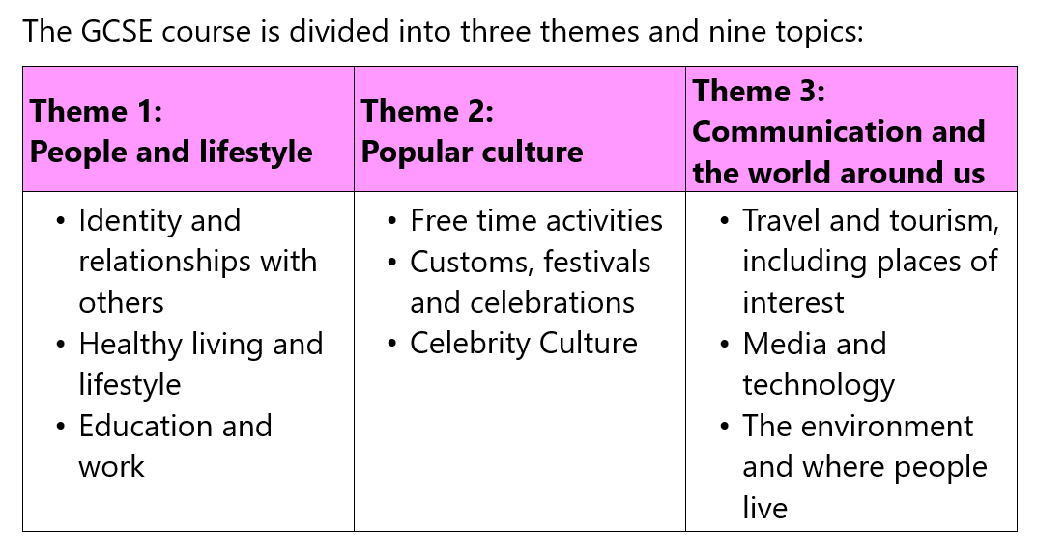
What will I study?

Slide 6
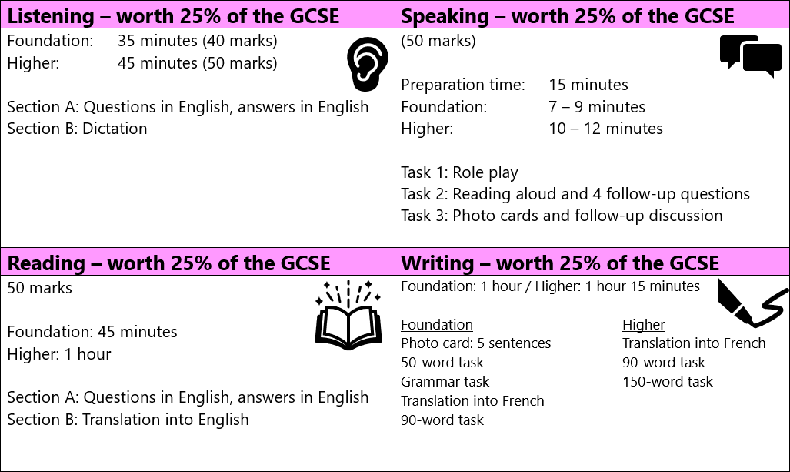
How will I be assessed?

Slide 7
Questions
Please look at the options booklet to find out more about the course content and examinations for GCSE French.
If you have any further questions, please contact Mr Banks on mbanks@johnogaunt.excalibur.org.uk

