Slide 1
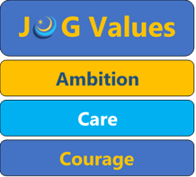

Religious studies
We live in a diverse society: understanding religious ideas, beliefs and outlooks, means we can have a better understanding of the world we live in.
Year 9
Options information

Slide 2

Critical Analysis
Exploring ethics
Emotional intelligence
Evaluation
Dealing with big questions
Debating and putting your point of view across
Challenging assumptions people make about our world
Argument (verbal and written)
Philosophical thinking
empathy
Celebrating similarity and difference
To understand social behaviours
Develop wide variety of SKILLS and KNOWLEDGE

Slide 3
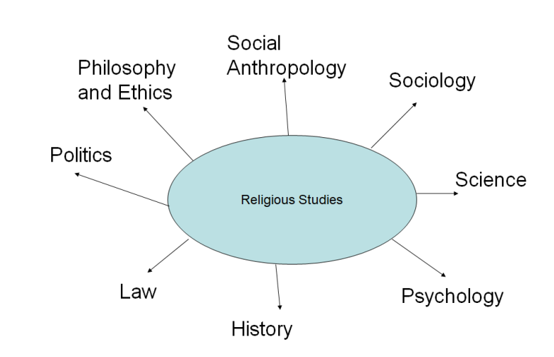
WHAT CAREERS DO PEOPLE WHO STUDY RS GO ON TO HAVE?
Advice worker
Archivist
Charity fundraiser
Charity officer
Civil Service administrator
Community development worker
Editorial assistant
Equality, diversity and inclusion officer
Mediator
Newspaper journalist
Policy officer
Solicitor
Youth worker
Teacher/ lecturer
Religious faith leader e.g. Priest or Rabbi
Philosopher
Ethics adviser
Social worker
Psychologist
RS can lead to lots of other areas which are also about connecting with humans, some of these roles require further study.
Notes:
And With this range of skills Geographers go into diverse fields, from meteorologists and national park officers, to rural and urban planners, we work in water and coastal management schemes or environmental and sustainable resources projects / the list is endless.

Slide 4
WHAT am I studying and how will I be assessed?
Subject content – AQA GCSE Religious Studies
Paper 1 – Christianity and Islam: Beliefs, teachings and practices 1 hour 45 mins
Paper 2 – Thematic studies: religious, philosophical and ethical studies (applying Christianity and Islam) 1 hour 45 mins
→ Relationships and Families
→ Religion and Life
→ Religion, Peace and Conflict
→ Religion, Crime and Punishment
Notes:
You will study – 3 papers paper 1 -the physical environment, paper 2 – the challenges in the human environment and paper 3 geographical applications

Slide 5
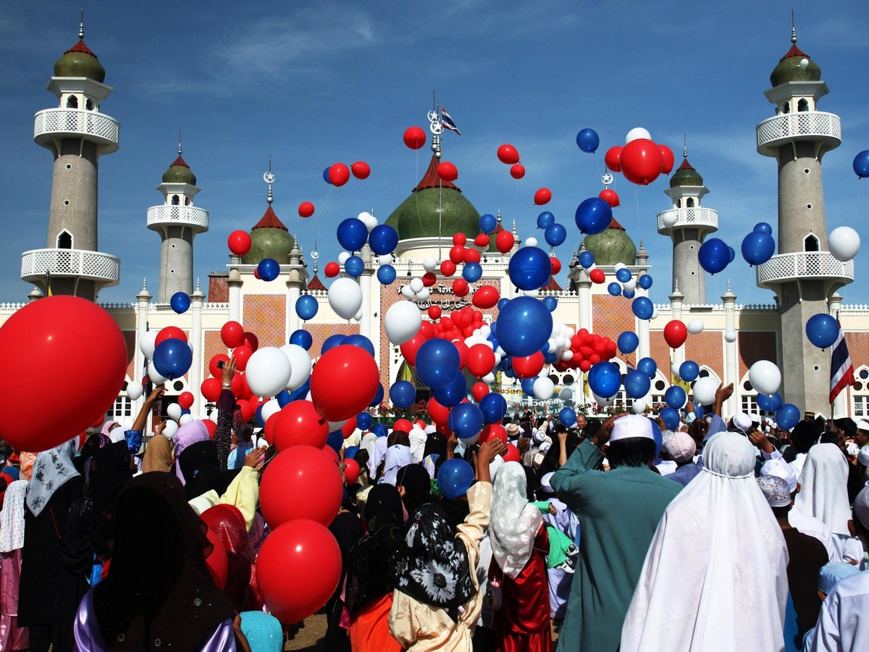
Islam beliefs, teachings and practices
How do Muslim beliefs impact their daily life?
What do Muslims belief and how is it similar to Christianity?

Slide 6
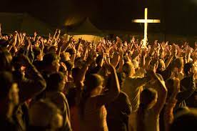
Christianity beliefs, teachings and practices
How do Christian beliefs impact their daily life?
How diverse are Christian beliefs?

Slide 7

Relationships and families
Human sexuality; Sexual relationships before and outside of marriage; Contraception and family planning; The nature and purpose of marriage; Polygamy; Same sex marriage and cohabitation; Divorce and remarriage; The nature and purpose of families; Roles of men and women; Gender equality and prejudice

Slide 8
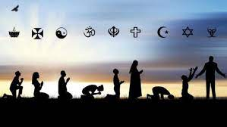
Origins of the universe; The value of the world; Environmentalism and stewardship; Use and abuse of animals; Origins of human life; Sanctity of human life; Abortion; Euthanasia; Is there life after death?
Religion and life

Slide 9
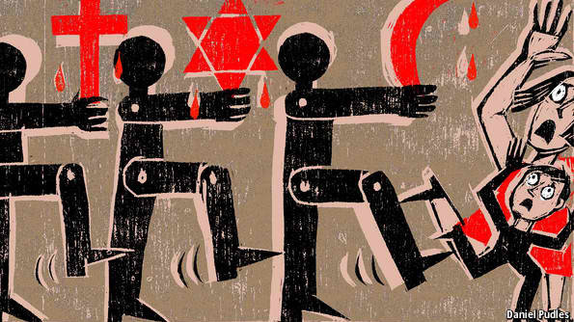
Religion, peace and conflict
Peace and justice; Forgiveness and reconciliation; Violence and violent protest; Terrorism; Causes of War; Just war theory; Holy war; Weapons of mass destruction; Pacifism and peacemaking; Victims of war

Slide 10

Law, crime and authority; Good and evil; Causes of crime; Different types of crime; Aims of punishment; Treatment of criminals; Forgiveness; The death penalty; Corporal punishment
Religion, crime and punishment

