Slide 1
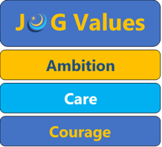

History
“History empowers us with the knowledge to challenge the certainty we have in today”
Options information
Year 9

Slide 2
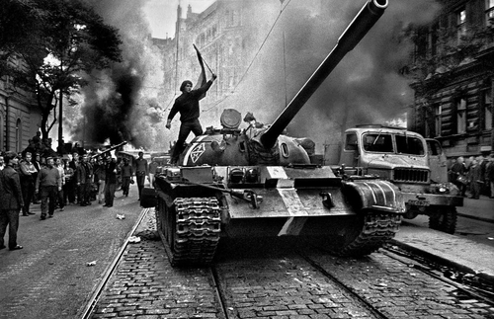
Critical Analysis
debating and arguing your point
interpreting photos, cartoons, diagrams…
Evaluating interpretations
Evaluation
convincing others you are right
decision making
Source analysis- how not to believe everything you see and read
Challenging assumptions people make about our world
problem solving
Narrative and argument writing
empathy
boosting your memory
Working with evidence
International relations
Develop wide variety of SKILLS and KNOWLEDGE
Notes:
a Huge variety of skills are gained in Geography which will be useful after school. These skills are highly sought after by Sixth Form Colleges, universities and employers/ Skills such as problem solving and analytical skills, Collaboration through teamwork, Consideration of other communities as / importantly we consider the wider-world

Slide 3
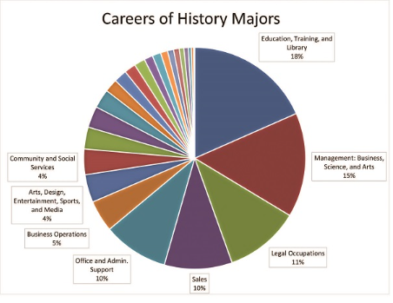
WHAT CAREERS DO PEOPLE WHO STUDY HISTORY GO ON TO HAVE?
Academic researcher
Archivist
Heritage manager
Historic buildings inspector
conservation officer
Museum education officer
Museum/gallery curator
Museum/gallery exhibitions officer
Secondary school teacher
Academic librarian
Archaeologist
Broadcast journalist
Civil Service administrator
Editorial assistant
Human resources officer
Information officer
Marketing executive
Policy officer
Politician's assistant
Politician
Solicitor
Lawyer
Historian
Television, radio and podcast broadcaster
History gives you the ability to think critically, synthesise a lot of information, deal with evidence and interpretation… all skills sought after by numerous employers and career paths.
Notes:
And With this range of skills Geographers go into diverse fields, from meteorologists and national park officers, to rural and urban planners, we work in water and coastal management schemes or environmental and sustainable resources projects / the list is endless.

Slide 4

WHAT am I studying?
Subject content – Edexcel GCSE History
Paper 1 –Crime and Punishment 1000AD-present, with Whitechapel Case Study c1870-1900.
Paper 2 – Early Elizabethan England and Superpower Relations and the Cold War.
Paper 3 – Weimar and Nazi Germany, 1918-1939
Notes:
You will study – 3 papers paper 1 -the physical environment, paper 2 – the challenges in the human environment and paper 3 geographical applications

Slide 5
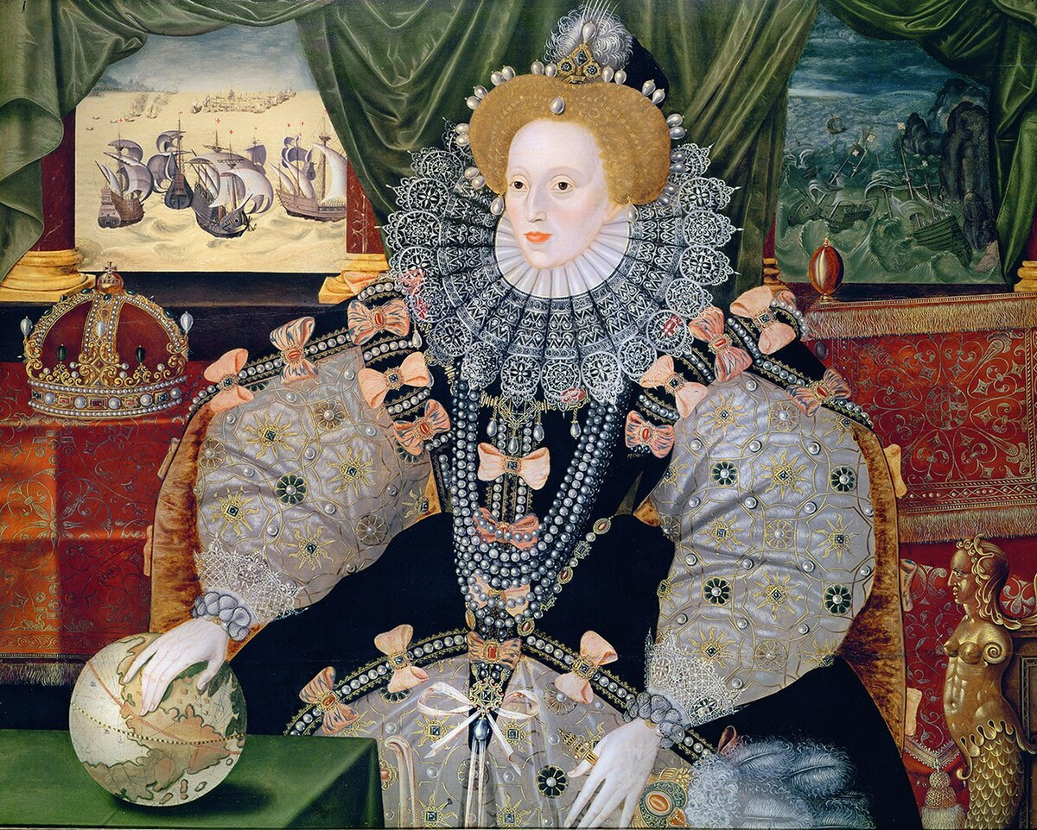
Early Elizabethan England
Great job
PROSPECTS
Was Elizabethan England really a golden age?
What do the Elizabethans reveal to us about the beginning of British colonialism ?
Notes:
Data from Higher Education Careers Services Uni
https://luminate.prospects.ac.uk/media/0d64ccf2-aeb9-488e-b77e-fccffa21ec92/what-do-graduates-do-2018-19.pdf

Slide 6

What do we mean by a nuclear deterrent?
How does the Cold War relate to the current invasion of Ukraine?
Superpower relations and the cold war

Slide 7
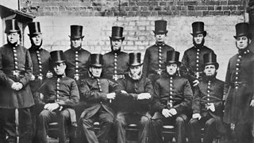
Crime and punishment, 1000ad-present
How far has crime and punishment changed since the medieval period?
Why was a professional police force formed in the 19th century?

Slide 8
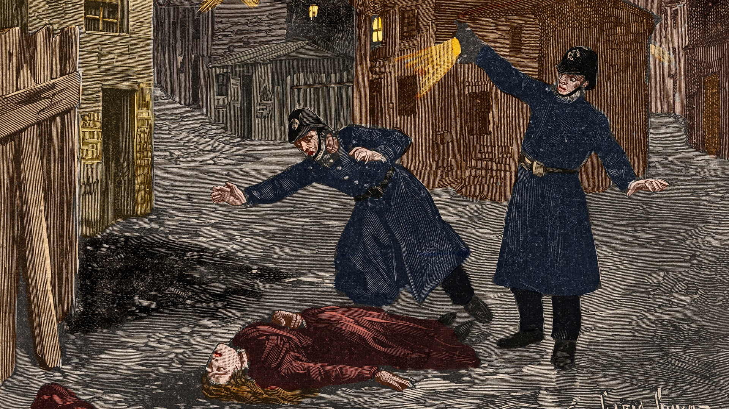
Case study: Whitechapel 1880s-1900
What do historical sources reveal about life and crime in 19th century East London?
Who were the women often forgotten in the Jack the Ripper murders?

Slide 9
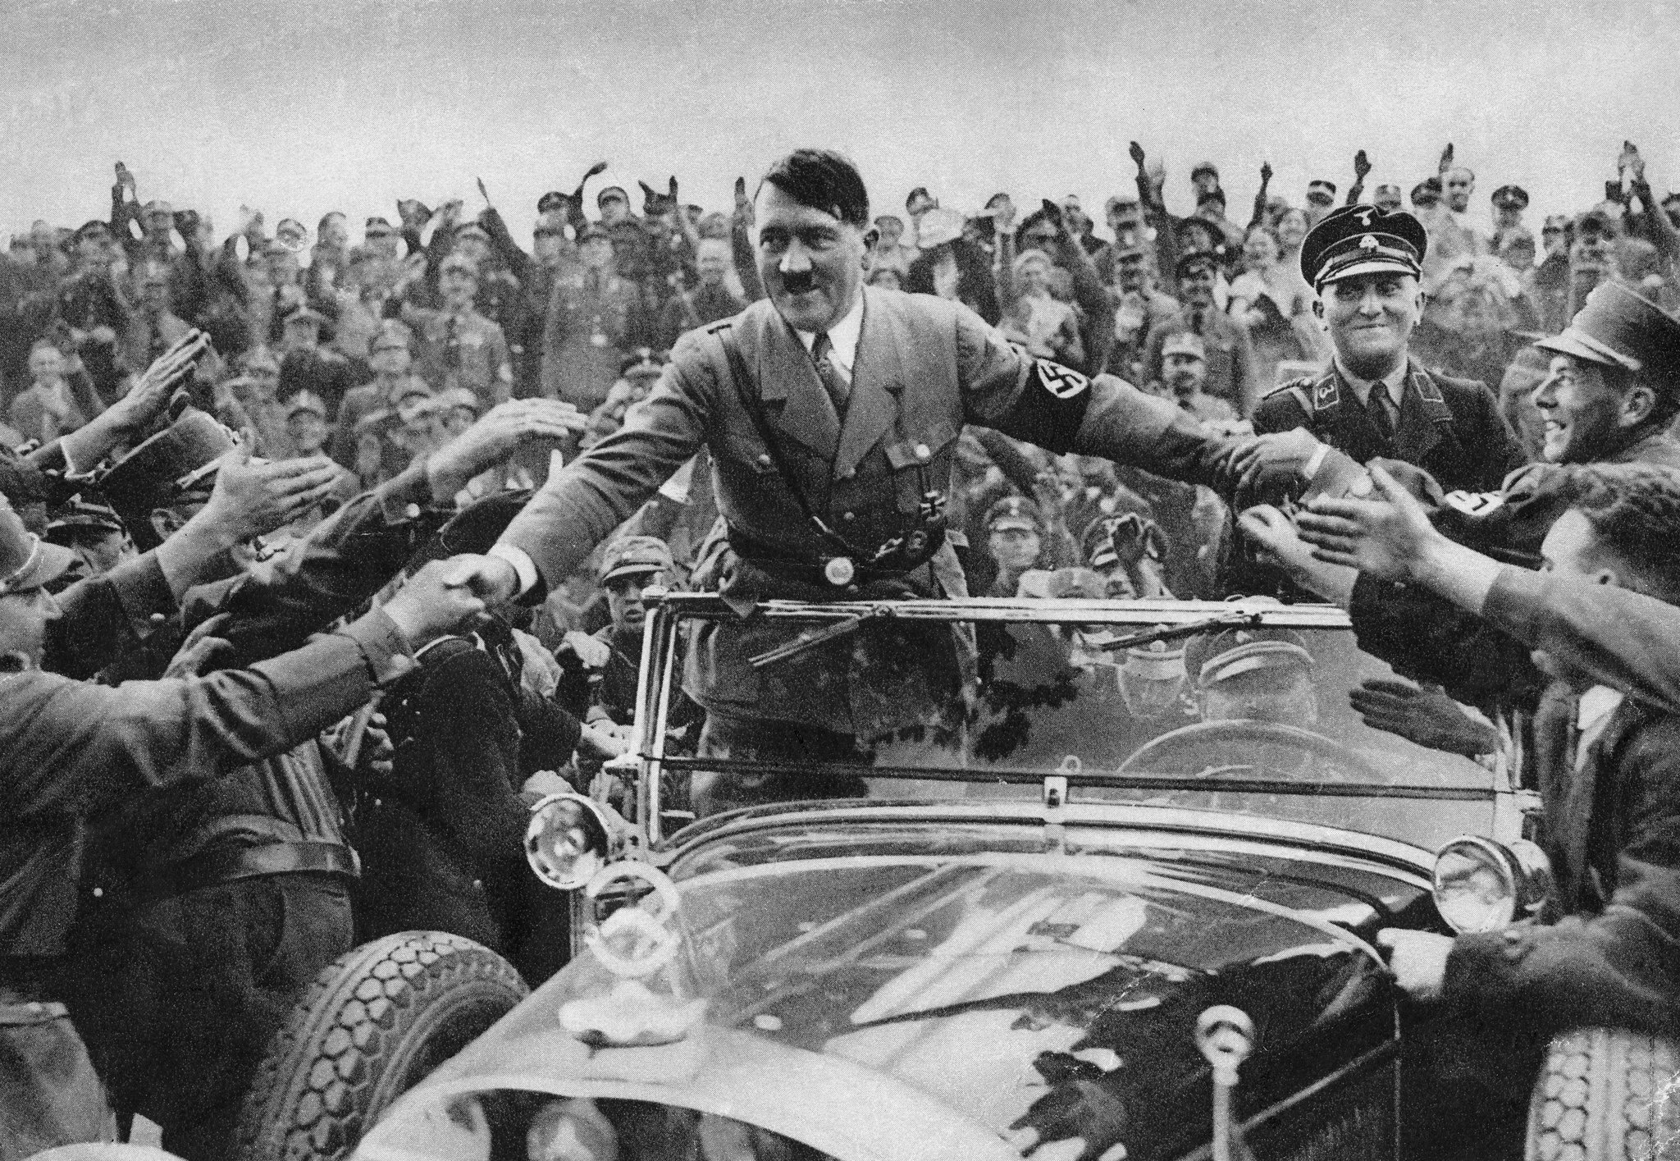
Weimar and nazi Germany
How far do historians agree about the rise and impact of the Nazis?
What can we learn about the rise of leaders today from the story of the Nazis in 1930s Germany?

Slide 10
HOW WILL I BE ASSESSED?
Three exams, covering four units.
Paper 1: Crime and Punishment 1000AD-present, with Whitechapel Case Study c1870-1900. 1 hour 15 mins.
Paper 2: Early Elizabethan England and Superpower Relations and the Cold War. 1 hour 45 mins.
Paper 3: Weimar and Nazi Germany, 1918-1939. 1 hour 20 mins.
Questions: a combination of knowledge, evaluation, source and interpretation questions. Smallest question is 4 marks, largest is 20 marks.

