Slide 1

Geography
"It's surely our responsibility to do everything within our power to create a planet that provides a home not just for us, but for all life on Earth."
Year 9 options information

Slide 2
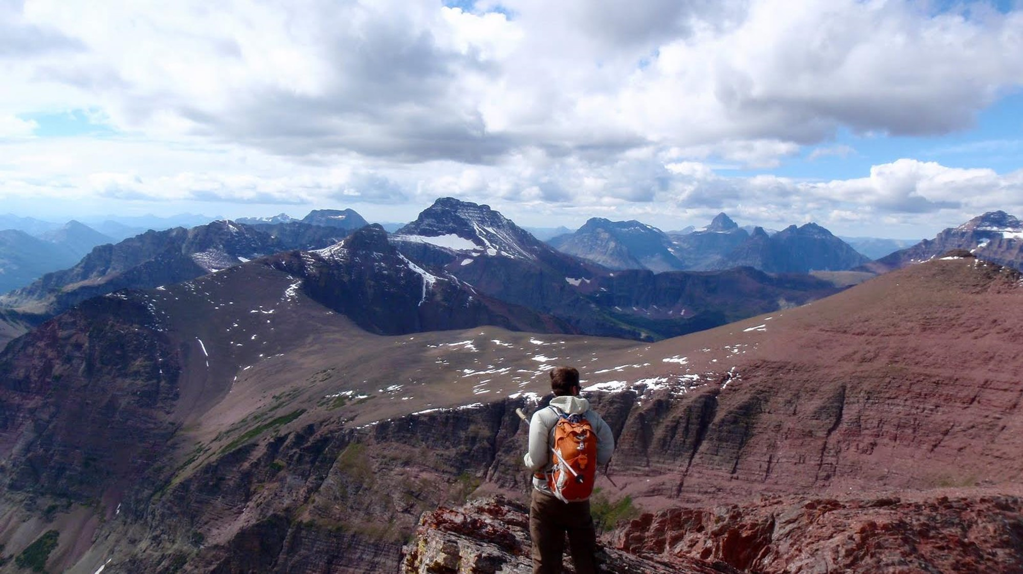

modern computer based mapping
debating and arguing your point
fieldwork
map skills
interpreting photos, cartoons, diagrams…
working with data
statistics
digital technologies
convincing others you are right
critical analysis
decision making
analysing articles
investigating issues in the real world
report writing
boosting your memory
problem solving
empathy
Develop wide variety of SKILLS
Notes:
a Huge variety of skills are gained in Geography which will be useful after school. These skills are highly sought after by Sixth Form Colleges, universities and employers/ Skills such as problem solving and analytical skills, Collaboration through teamwork, Consideration of other communities as / importantly we consider the wider-world

Slide 3
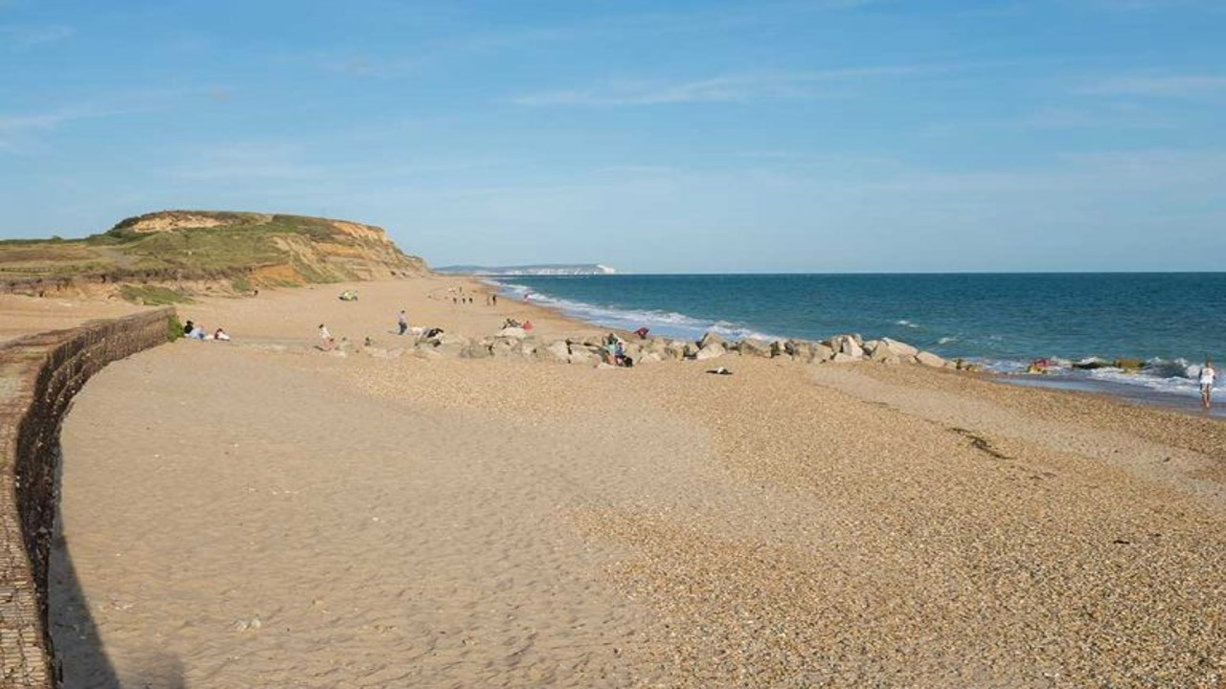

Skills developed through high quality Fieldwork
Notes:
These Skills are developed through range of classwork, GIS, research and fieldwork

Slide 4
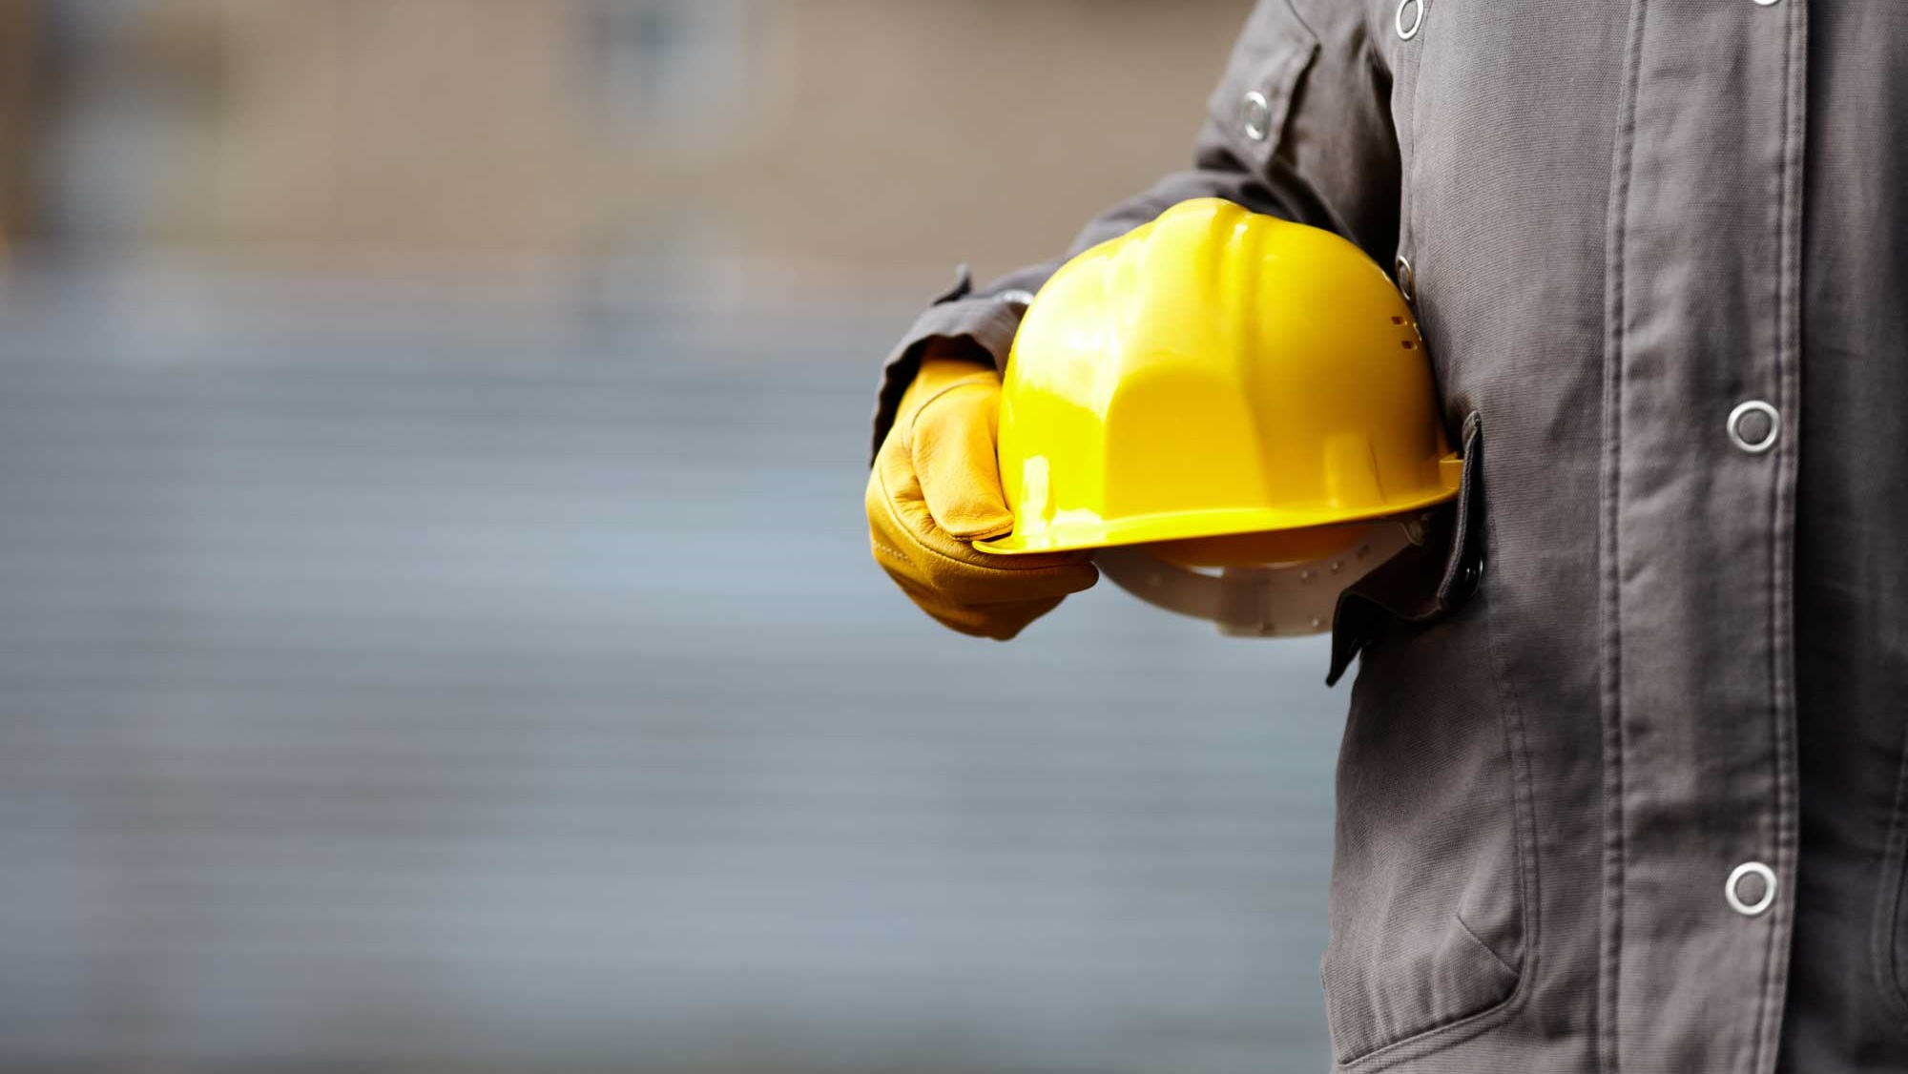

Unemployment rate (2018-2019):
Geography 4.8%
(six months after graduation)
Great job
PROSPECTS
Notes:
Geographers do not struggle to get a job! If you study Geography at any level – GCSE, A Level, uni, this is a good thing!
Data from Higher Education Careers Services Uni
https://luminate.prospects.ac.uk/media/0d64ccf2-aeb9-488e-b77e-fccffa21ec92/what-do-graduates-do-2018-19.pdf

Slide 5

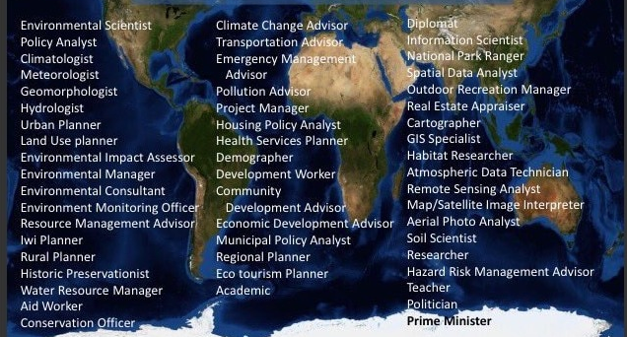
WHAT CAREERS COULD GEOGRAPHER’S DO?
Notes:
And With this range of skills Geographers go into diverse fields, from meteorologists and national park officers, to rural and urban planners, we work in water and coastal management schemes or environmental and sustainable resources projects / the list is endless.

Slide 6

WHAT am I studying?
Subject content – AQA GCSE GEOGRAPHY
Paper 1 – Living with the physical environment
Paper 2 – Challenges in the human environment
Paper 3 – Geographical Applications
        Issue Evaluation
        Fieldwork
Notes:
You will study – 3 papers paper 1 -the physical environment, paper 2 – the challenges in the human environment and paper 3 geographical applications

Slide 7
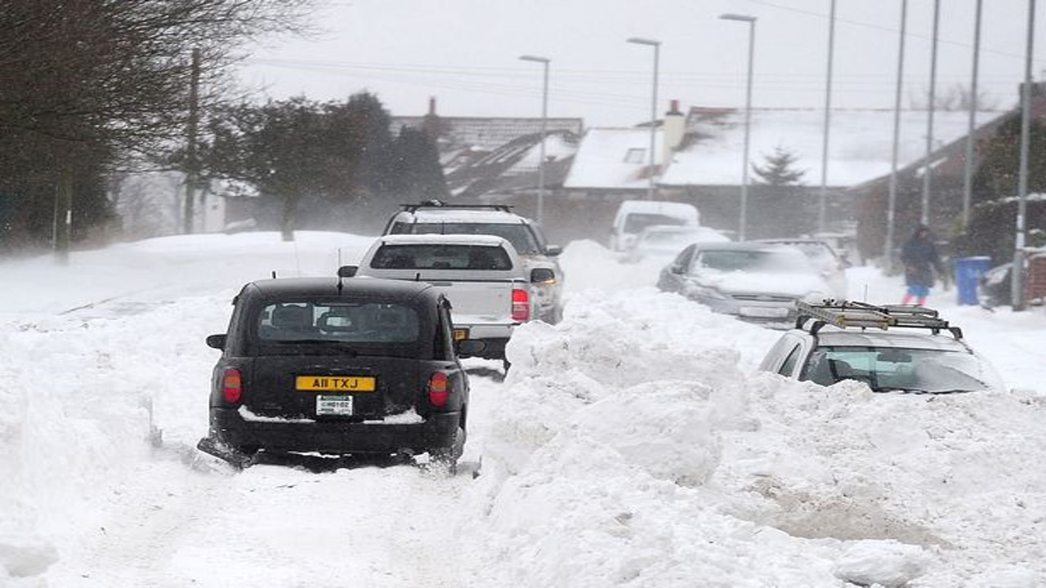

The Challenge of
NATURAL HAZARDS
Are earthquakes the deadliest natural hazard?
What can we do to prepare as UK weather becomes more extreme?
Notes:
In paper 1 You will learn about extreme weather, earthquakes, tsunamis, hurricanes, volcanoes - not just how they’re caused but the effect on people and how people should or could respond, and how responses vary.

Slide 8
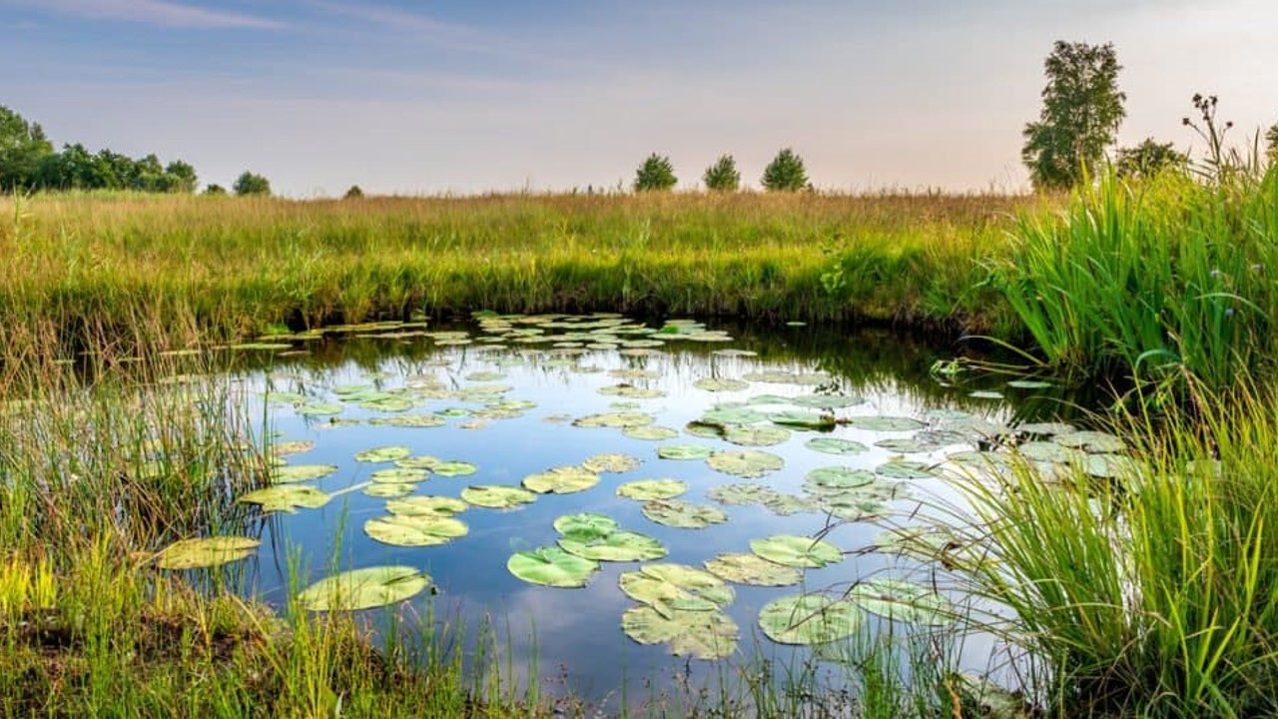
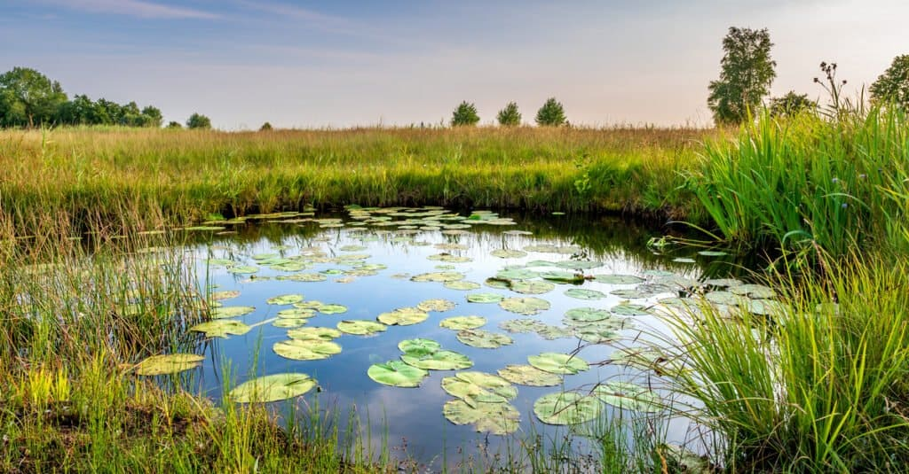

The living
WORLD
What if all the world’s rainforests were cut down?
How do plants and animals survive here?
Notes:
Ecosystems – small ecosystem & rainforests, hot and cold Environments – adaptations, management schemes, effect of deforestation or drainage of habitats.

Slide 9
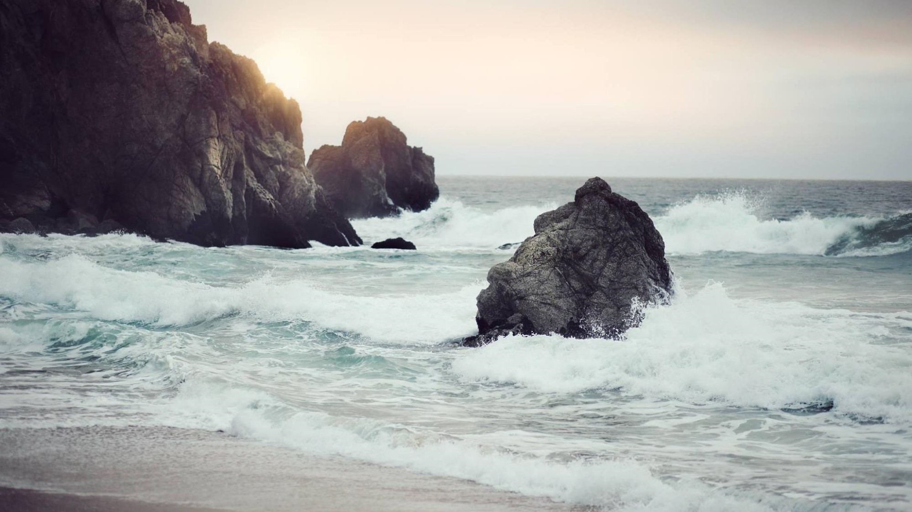
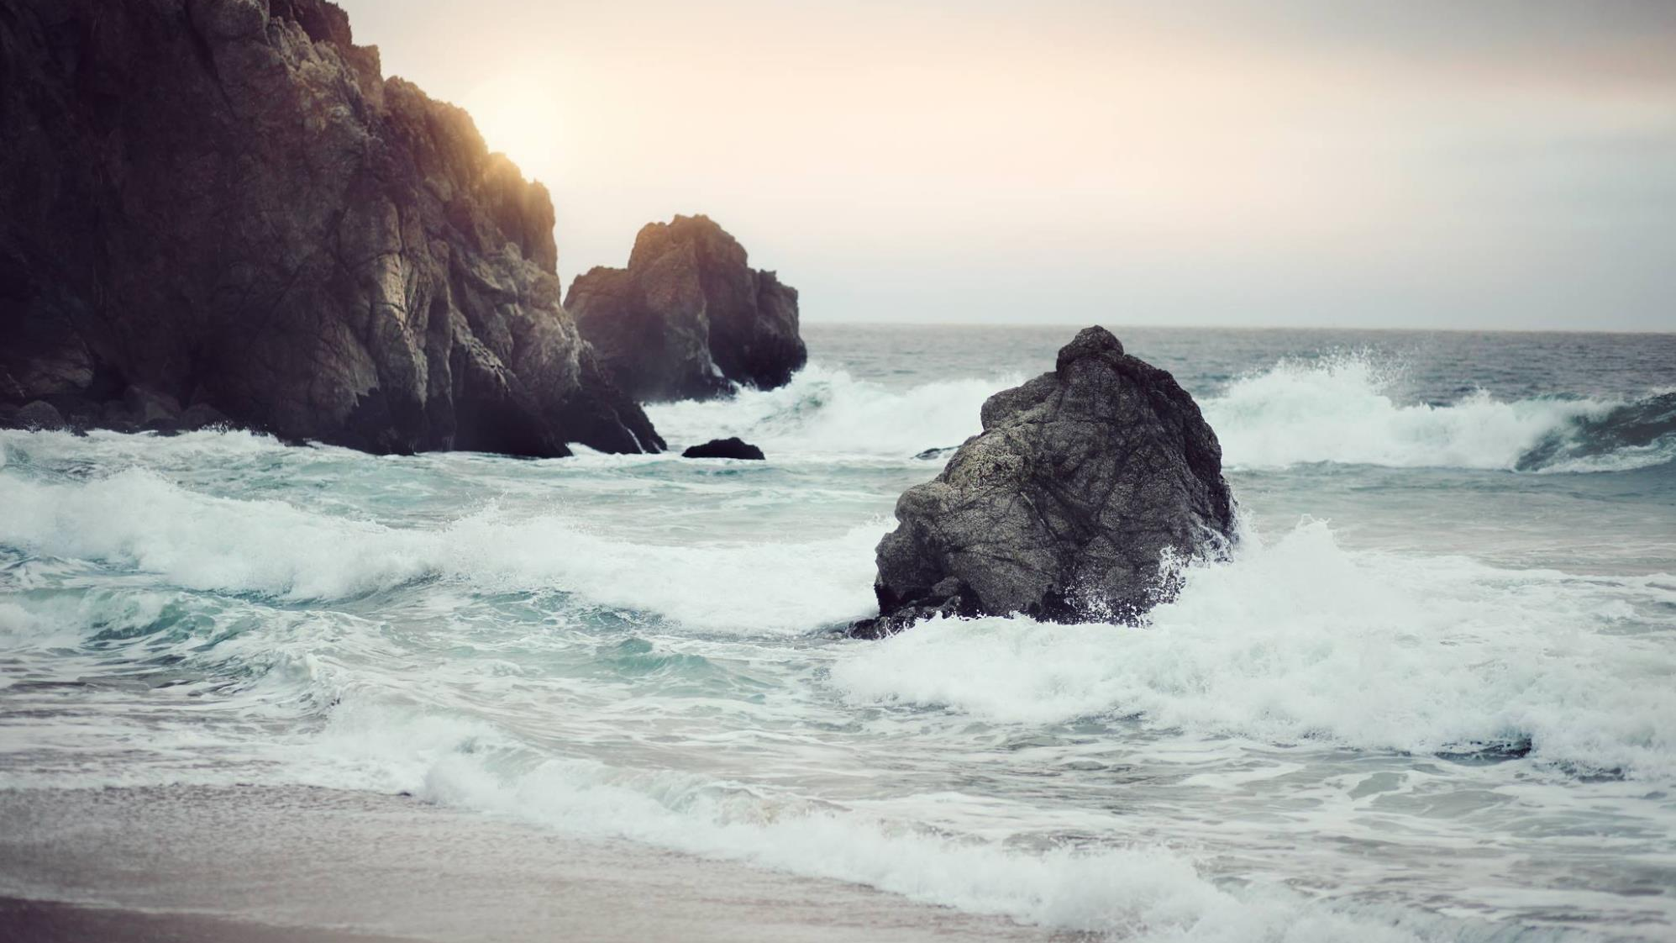
Physical landscapes
coasts
Why are millions of properties at risk of falling into the sea?
How should we protect our coastlines?
Notes:
Coastal landforms and the formation, and the management of coastal areas – We are an island.. can we protect all communities with rising sea levels and crumbling coastlines?

Slide 10
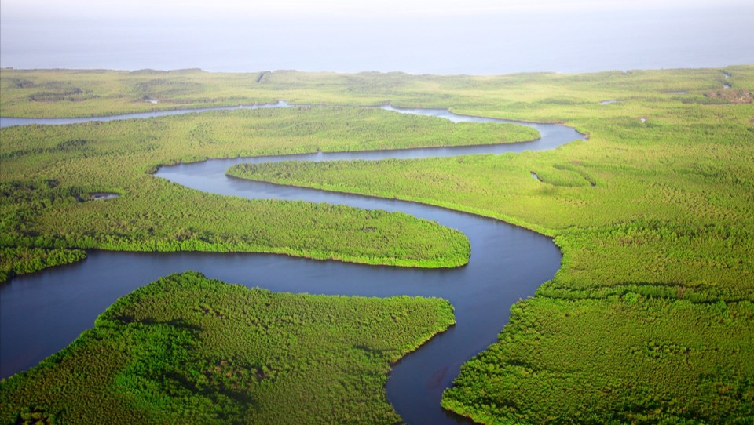
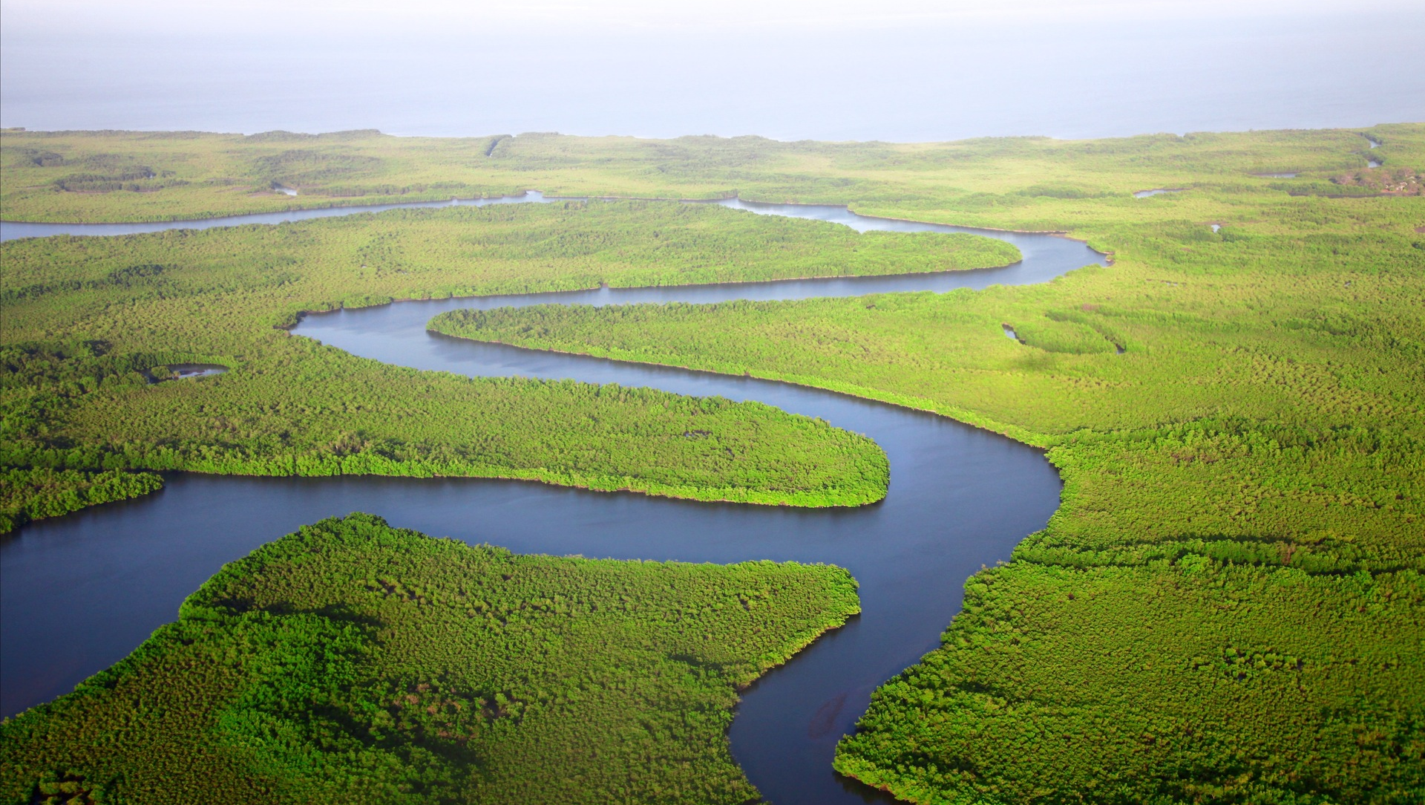
Why can rivers be deadly?
Why do people live near rivers that flood?
Physical landscapes
RIVERS
Notes:
We will look at river landscapes – and with the pressure for housing to meet growing populations, how can we meet demand whilst preserving natural habitats, and protect communities from devastating floods.

Slide 11
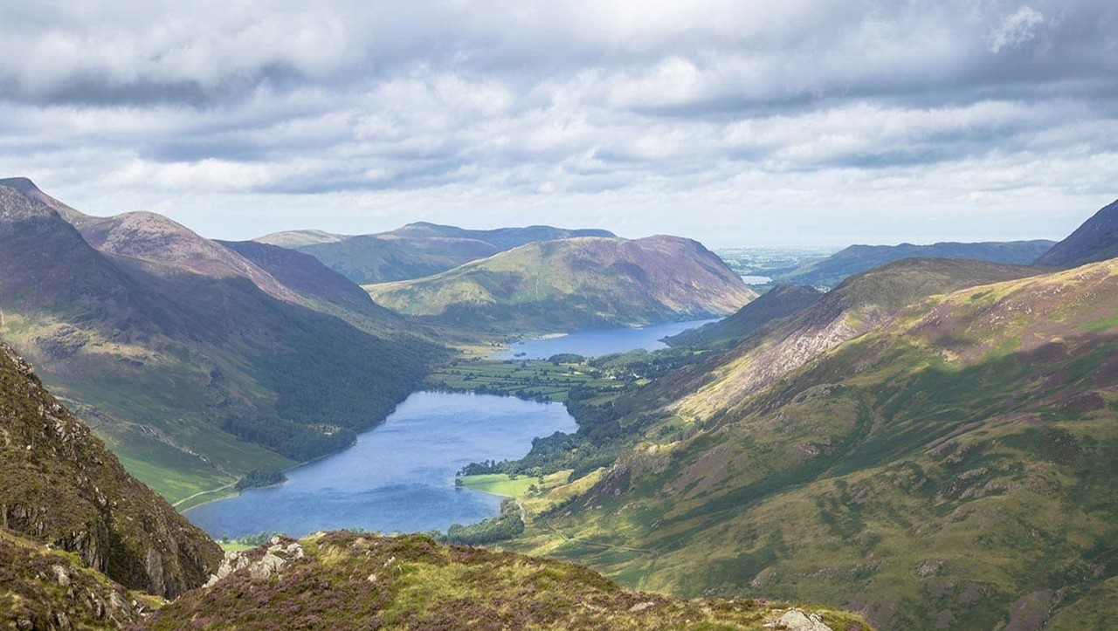
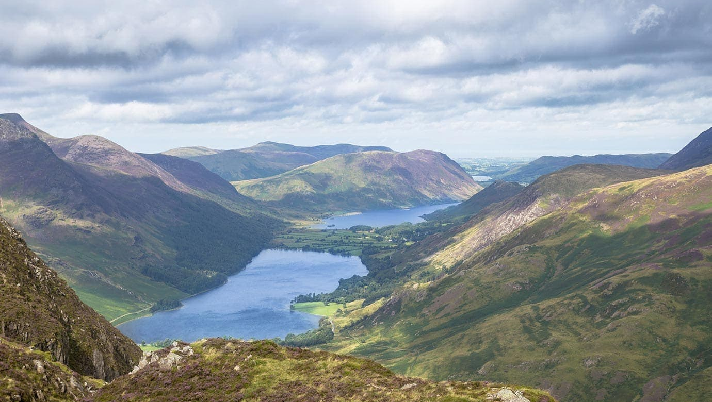
How can tourists enjoy these areas without destroying it?
How did ice change this landscape?
Physical landscapes
Glacial landscapes
Notes:
And in Glaciated upland areas – we investigate balancing the demand for employment and economic development, where tourism provides opportunities but tourist numbers threaten the landscape …

Slide 12
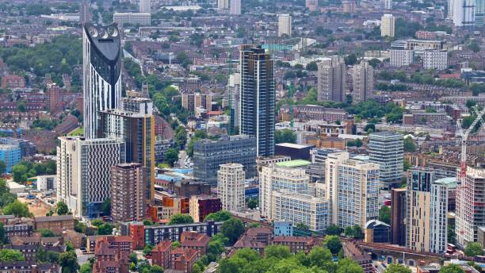
Are cities in crisis?
Urban issues and
CHALLENGES
What if there were no areas of countryside?
Notes:
In Paper 2 – Challenges in the human environment You will look at the problem and development of some the most important cities in the world today including London (UK), Lagos (Nigeria) and Rio de Janeiro (Brazil)
(Globally, over 50% of the population lives in urban areas today) (. By 2045, the world's urban population will increase by 1.5 times to 6 billion) will learn about some of

Slide 13


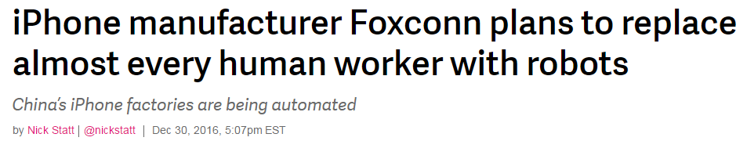
The changing
Economic world
How will new technology affect business and trade?
How can we ensure that all countries can develop?
Notes:
You will Investigate strategies that exist for reducing the global development gap, by supporting countries experiencing rapid economic development leading to significant social, environmental and cultural change.
.(Globalisation, business, jobs, technology, TNCs)

Slide 14
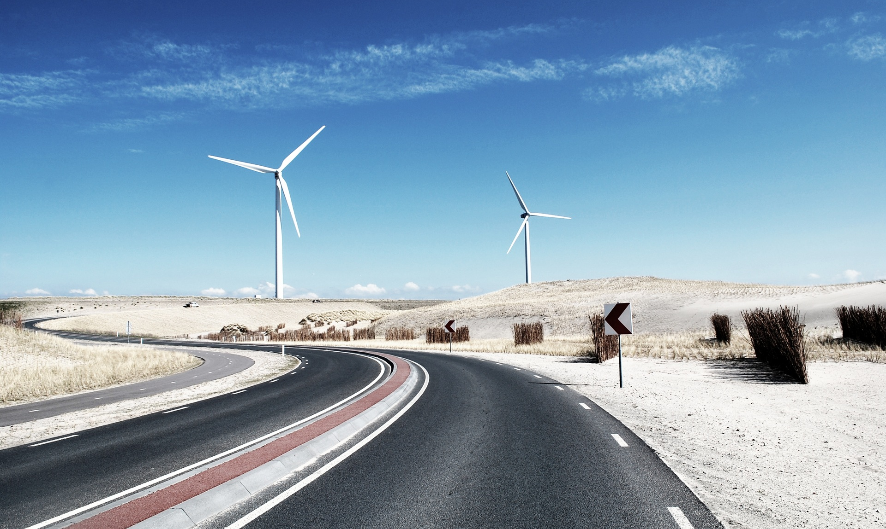
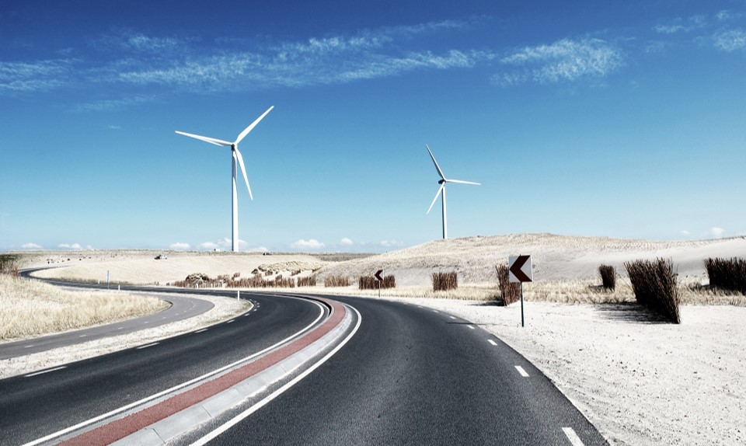
The challenge of
resource management
What if all power was renewable?
Are we running out of resources?
Notes:
and Resource Management / a very current concept. We look at the problems and potential solutions to achieve this .

Slide 15
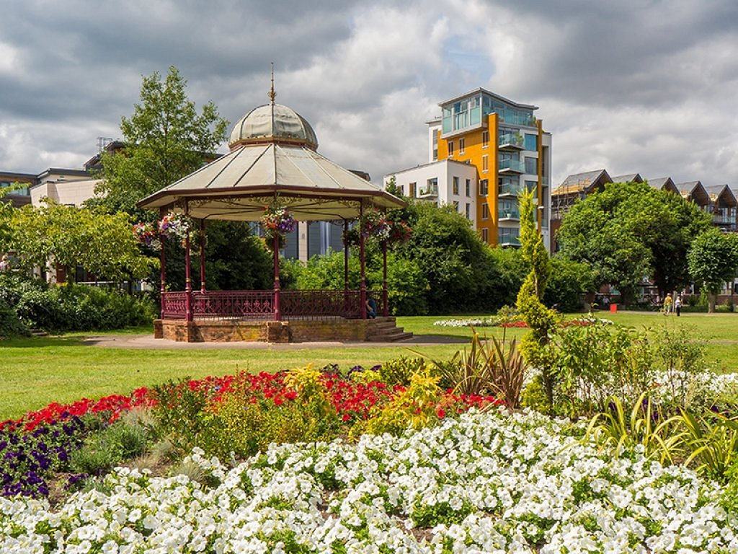
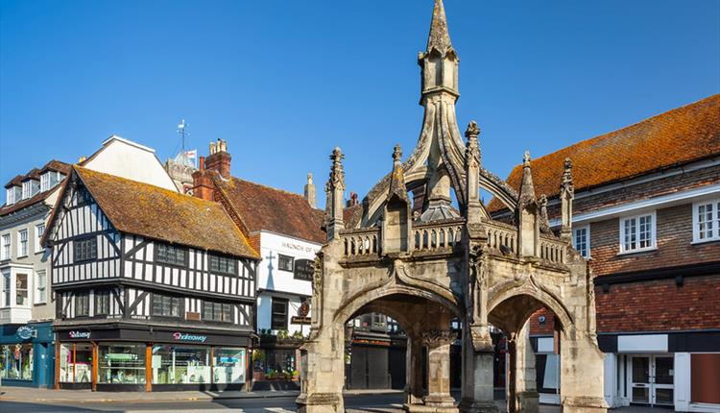
YEAR 10
Human
FIELDWORK
What if there was no pollution?
Notes:
In paper 3 – we Carry out geographical investigation in Newbury –Considering the Quality of redevelopment of an urban recreation area -

Slide 16
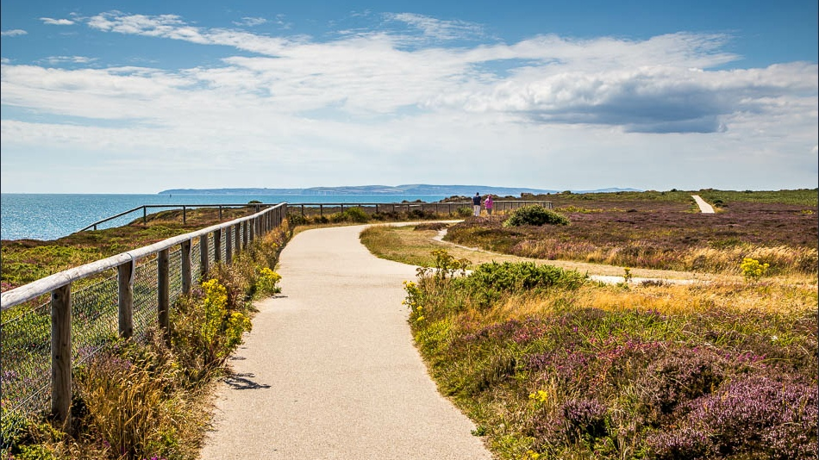
YEAR 10
Physical FIELDWORK
Should all coastlines be protected?
Notes:
…and also at Hengistbury Head – collecting primary data, reviewing coastal management methods whilst investigating evidence for Longshore Drift.

Slide 17
HOW WILL I BE ASSESSED?
Three examinations at the end of Year 11:
Unit 1 (1hr 30mins) tests Physical Geography (3 topics)
Unit 2 (1hr 30mins) tests Human Geography (3 topics)
Unit 3 (1hr 30mins) tests Fieldwork and contains a pre studied Issue Evaluation Exercise
Notes:
You will be assessed in Unit 1 and 2 with 1 ½ hour papers testing and applying knowledge. Throughout you will need to use geographical skills
We’ll do a lot of preparation for Unit 3 – half on the fieldwork investigation
The Decision making Exercise is where a resources booklet will be released, twelve weeks before the Unit 3 examination,. This booklet will contain information about a current and controversial geographical issue. So before you go into the Unit 3 exam, you will have a strong idea about the content and possible questions that may come up, but Half of paper 3 will be based on this issue..

Slide 18
FREQUENTLY ASKED QUESTIONS:
What field work do I complete?
You need to be committed to attending the COMPULSORY field trips; and completing all the tasks before and after the trips that relates to each investigation.
.
What is the Issue Evaluation?
The Issue Evaluation is a task that is shared 12 weeks before the exam. You need to be committed to studying this over Easter.
Notes:
You will need to be committed to completing the 2 compulsory field trips and completing all the tasks before and after the trip that relates to each investigation.
You will need to be fully engaged in the decision making exercise Unit 3 – as completing, contributing and working hard to understand the investigation is essential.

